Slide 1
I-V Characteristics (pMOS)
pMOS transistors behave in the same way, but with the signs of all voltages and currents reversed.
So, All doping and voltages are inverted for pMOS
Source is the more positive terminal
The mobility of holes in silicon is typically lower than that of electrons. This means that pMOS transistors provide less current than nMOS transistors of comparable size and hence are slower.
Mobility μ_{p} is determined by holes
Typically 2 lower than that of electrons μ_{n}
μ_{n} = μ_{p} * 2

Slide 2
MOS Capacitor
Gate and body form MOS capacitor
Operating modes
Accumulation
Depletion
Inversion
Notes:
Page 61 for details

Slide 3
C-V Characteristics
The total capacitance is due to the gate oxide capacitance C_{ox} when the MOS device is OFF (V_{gs}<V_{t}).
When the gate voltage is increased to the threshold voltage, the depletion layer capacitance C_{d} arises in series with the gate oxide capacitance. Hence, the total capacitance decreases to a value
(C_{ox} C_{d} )/ (C_{ox} +C_{d} ).
With the increase in gate voltage, the depletion region thickness continues to increase and the depletion layer capacitance continues to increase. Hence, the total capacitance continues to decrease.
13-Sep-20

Slide 4
C-V Characteristics
Once the inversion is reached, the depletion layer thickness no longer grows and the capacitance becomes constant.
But at high frequencies, the capacitance again increases as gate voltage is increased beyond the threshold voltage.
At low frequencies ,the inversion layer charge cannot respond to these frequencies.
This is due to the fact that the inversion layer charge establishment is accomplished by the generation–recombination process.
13-Sep-20

Slide 5
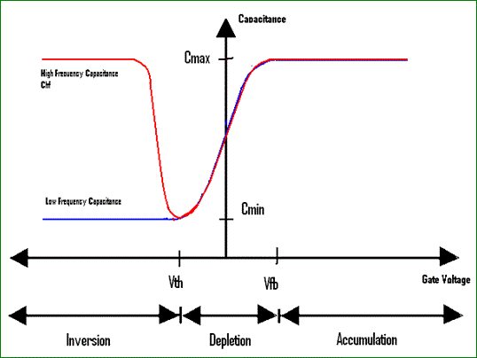
Figure 3: C-V of MOS

Slide 6
C-V Characteristics
Combining the gate voltages intensity, we can obtain capacitance vs. voltage. Also, we will consider frequency components in the signal. The C-V looks like this
Flat Band voltage separates the Accumulation from the depletion
Threshold Voltage separates the Inversion region from the depletion
Both high and low frequency have same effect while on accumulation
During Inversion, High frequency extracts more capacitance than low frequency components

Slide 7
Coffee Cart Analogy
Tired student runs from VLSI lab to coffee cart
Freshmen are pouring out of the physics lecture hall
V_{ds} is how long you have been up
Your velocity = fatigue × mobility
V_{gs} is a wind blowing you against the glass (SiO₂) wall
At high V_{gs}, you are buffeted against the wall
Mobility degradation
At high V_{ds}, you scatter off freshmen, fall down, get up
Velocity saturation

Slide 8
Ideal I-V
Shockley long-channel transistor models

Slide 9
Non-Ideal I-V
In reality, when we simulate our circuit and obtain the graph, we see couple of departure from the ideal values in the graph
As the gate voltage increases linearly, Current does not increase linearly
The saturation current is always below the expected outcome
This phenomenon is caused by two factors : Velocity Saturation & Mobility Degradation

Slide 10
Ideal vs. Simulated nMOS I-V Plot
Non-Ideal I-V
65 nm IBM process, V_{DD} = 1.0 V

Slide 11
Non-Ideal I-V
Velocity Saturation
Mobility Degradation
Velocity is connected to voltage and lateral size
At high lateral field strength, velocity stops to keep pace.
Mobility of our carriers depend on vertical thickness.
After a certain extension of vertical profile, the mobility degrades enormously.

Slide 12
Non-Ideal I-V
Velocity Saturation
Mobility Degradation
The reason the velocity saturates is clear from practical point since (V_{ds}/L) will change as the L increases. After a certain extension of L, the field strength, here the electromagnetic force E, does not force the conduction for resource constraints.
At high vertical field strength, the carrier scatters off the oxide interface frequently.
This causes the mobility to reduce; in ideal scenario we cannot consider such condition.
Hence the graph is different for ideal and non-ideal.

Slide 13
Non-Ideal I-V
Vertical electric field: E_{vert} = V_{gs} / t_{ox}
Attracts carriers into channel
Long channel: Q_{channel} ∝ E_{vert}
Lateral electric field: E_{lat} = V_{ds} / L
Accelerates carriers from drain to source
Long channel: v = μE_{lat}

Slide 14
Mobility Degradation
High E_{vert} effectively reduces mobility
Collisions with oxide interface

Slide 15
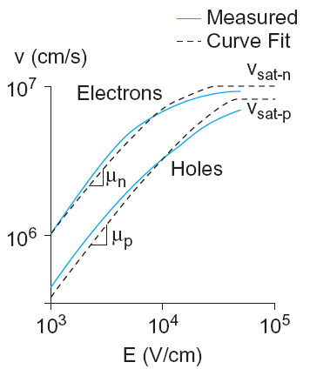
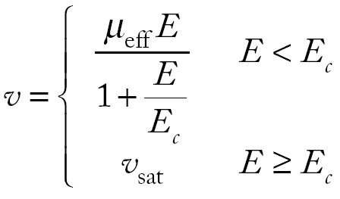
Velocity Saturation
At high E_{lat}, carrier velocity rolls off
Carriers scatter off atoms in silicon lattice
Velocity reaches v_{sat}
Electrons: 10⁷ cm/s
Holes: 8 x 10⁶ cm/s
Better model

